Slide 1
Computer Networks
[Network Topology]

Slide 2
What is Network Topology?
Topology defines the structure of the network of how all the components are interconnected to each other.
There are two types of topology:
Physical Topology
Logical Topology

Slide 3
Types of Network Topology
Physical topology is the geometric representation of all the nodes in a network.
There are six types of network topology which are
Bus Topology
Ring Topology
Tree Topology
Star Topology
Mesh Topology
Hybrid Topology

Slide 4
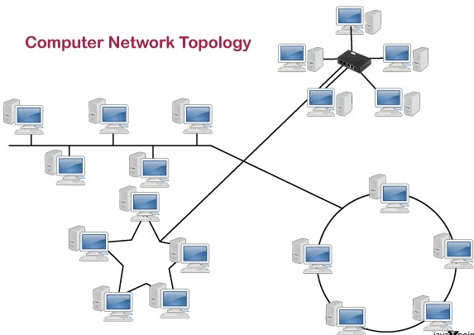

Slide 5
Bus Topology
The bus topology is designed in such a way that all the stations are connected through a single cable known as a backbone cable.
Each node is either connected to the backbone cable by drop cable or directly connected to the backbone cable.
When a node wants to send a message over the network, it puts a message over the network.
All the stations available in the network will receive the message whether it has been addressed or not.

Slide 6
Bus Topology
The bus topology is mainly used in 802.3 (ethernet) and 802.4 standard networks.
The configuration of a bus topology is quite simpler as compared to other topologies.
The backbone cable is considered as a "single lane" through which the message is broadcast to all the stations.
The most common access method of the bus topologies is CSMA
(Carrier Sense Multiple Access).

Slide 7
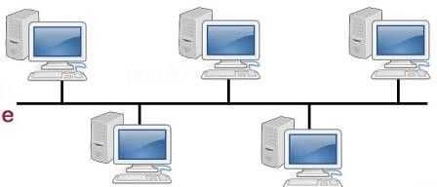
Bus Topology
Terminator
Network Backbone
Droplines / Drop cables

Slide 8
CSMA
It is a media access control used to control the data flow so that data integrity is maintained, i.e., the packets do not get lost.
There are two alternative ways of handling the problems that occur when two nodes send the messages simultaneously.
CSMA CD (Collision Detection)
CSMA CA (Collision Avoidance)

Slide 9
CSMA
CSMA CD
CSMA CD (Collision Detection) is an access method used to detect the collision.
Once the collision is detected, the sender will stop transmitting the data.
Therefore, it works on "recovery after the collision".
CSMA CA
CSMA CA (Collision Avoidance) is an access method used to avoid the collision by checking whether the transmission media is busy or not.
If busy, then the sender waits until the media becomes idle.
This technique effectively reduces the possibility of the collision.
It does not work on "recovery after the collision".

Slide 10




Advantages of Bus Topology
Moderate Data Speeds
Familiar Technology
Low-cost Cable
Limited Failure
In bus topology, nodes are directly connected to the cable without passing through a hub.
Therefore, the initial cost of installation is low.
Coaxial or twisted pair cables are mainly used in bus-based networks that support up to 10 Mbps.
Bus topology is a familiar technology as the installation and troubleshooting techniques are well known, and hardware components are easily available.
A failure in one node will not have any effect on other nodes.

Slide 11





Disadvantages of Bus Topology
A bus topology is quite simpler, but still it requires a lot of
cabling.
It requires specialized test equipment to determine the cable faults. If any fault occurs in the cable, then it would disrupt the communication for all the nodes.
If two nodes send the messages simultaneously, then the signals of both the nodes collide with each other.
Adding new devices to the network would slow down the
network.
Attenuation is a loss of signal leads to communication issues. Repeaters are used to regenerate the signal.
Extensive cabling:
Difficult troubleshooting:
Signal interference:
Reconfiguration
difficult:
Attenuation:

Slide 12
Ring Topology
Ring topology is like a bus topology, but with connected ends.
The node that receives the message from the previous computer will
retransmit to the next node.
The data flows in one direction, i.e., it is unidirectional.
The data flows in a single loop continuously known as an endless loop.
It has no terminated ends, i.e., each node is connected to other node and
having no termination point.
The data in a ring topology flow in a clockwise direction.
The most common access method of the ring topology is token passing.
Token passing: It is a network access method in which token is passed from one node to
another node.
Token: It is a frame that circulates around the network.

Slide 13
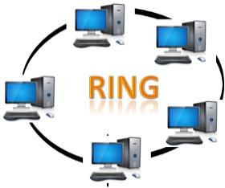
Ring Topology

Slide 14
Working of Token Passing
A token moves around the network, and it is passed from computer to
computer until it reaches the destination.
The sender modifies the token by putting the address along with the
data.
The data is passed from one device to another device until the
destination address matches.
Once the token received by the destination device, then it sends the
acknowledgment to the sender.
In a ring topology, a token is used as a carrier.
There are two types of token release techniques:
Early token release releases the token just after transmitting the data and
Delayed token release releases the token after the acknowledgment is received from the receiver.

Slide 15




Advantages of Ring Topology
Faulty devices can be removed from the network without bringing the network down.
Many hardware and software tools for network operation and monitoring are available.
Twisted pair cabling is inexpensive and easily available. Therefore, the installation cost is very low.
It is a more reliable network because the communication system is not dependent on the single host computer.
Network Management
Product availability
Cost
Reliable

Slide 16




Disadvantages of Ring Topology
Difficult Troubleshooting
Reconfiguration Difficult
Failure
Delay
It requires specialized test equipment to determine the cable faults. If any fault occurs in the cable, then it would disrupt the communication for all the nodes.
Communication delay is directly proportional to the number of nodes. Adding new devices increases the communication delay.
The breakdown in one station leads to the failure of the overall network.
Adding new devices to the network would slow down the network.

Slide 17
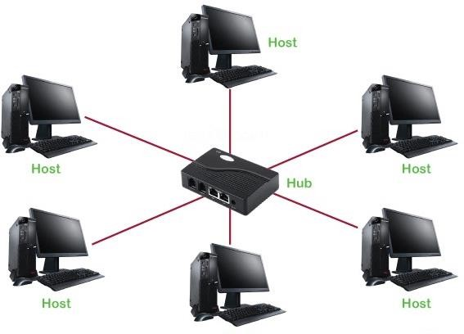
Star Topology
All the hosts in Star topology are connected to a central device, known as hub device, using a point-to-point connection.

Slide 18
Star Topology
Star topology is an arrangement of the network in which every node is connected to the central hub, switch or a central computer.
The central computer is known as a server, and the peripheral devices attached to the server are known as clients.
Coaxial cable or RJ-45 cables are used to connect the computers.
Hubs or Switches are mainly used as connection devices in a physical star topology.
Star topology is the most popular topology in network implementation.

Slide 19


Advantages of Star Topology
Troubleshooting is quite efficient in a star topology as compared to bus topology. In a bus topology, the manager has to inspect the kilometers of
Efficient troubleshooting:
cable. In a star topology, all the stations are connected to the centralized network. Therefore, the network administrator has to go to the single station to troubleshoot the problem.
Complex network control features can be easily implemented in the star topology. Any changes made in the star topology are automatically accommodated.
As each station is connected to the central hub with its own cable, therefore failure in one cable will not affect the entire network.
Star topology is a familiar technology as its tools are cost-effective.
It is easily expandable as new stations can be added to the open ports on
the hub.
Star topology networks are cost-effective as it uses inexpensive coaxial cable.
It supports a bandwidth of approx 100Mbps. Ethernet 100BaseT is one of the most popular Star topology networks.
Network control:
Limited failure:
Familiar technology: Easily expandable:
Cost effective:
High data speeds:

Slide 20


Disadvantages of Star Topology
A Central point of
failure
If the central hub or switch goes down, then all the connected nodes will not be able to communicate with each other.
Cable
Sometimes cable routing becomes difficult when a significant amount of routing is required.

Slide 21
Tree Topology
Tree topology combines the characteristics of bus topology and star topology.
A tree topology is a type of structure in which all the computers relate to each other in hierarchical fashion.
The top-most node in tree topology is known as a root node, and all other nodes are the descendants of the root node.
There is only one path exists between two nodes for the data transmission. Thus, it forms a parent-child hierarchy.

Slide 22
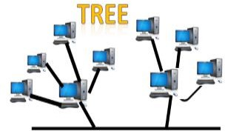
Tree Topology

Slide 23






Advantages of Tree Topology
Support for broadband Tree topology is mainly used to provide broadband transmission, i.e.,
transmission
signals are sent over long distances without being attenuated.
Easily expandable
We can add the new device to the existing network. Therefore, we can say
that tree topology is easily expandable.
Easily manageable
In tree topology, the whole network is divided into segments known as star
networks which can be easily managed and maintained.
Error detection
Error detection and error correction are very easy in a tree topology.
Limited failure
The breakdown in one station does not affect the entire network.
Point-to-point wiring
It has point-to-point wiring for individual segments.

Slide 24




Disadvantages of Tree Topology
If any fault occurs in the node, then it becomes difficult to troubleshoot the problem.
Devices required for broadband transmission are very costly.
A tree topology mainly relies on main bus cable and failure in main bus cable will damage the overall network.
If new devices are added, then it becomes difficult to reconfigure.
Difficult
Troubleshooting
High Cost
Failure
Reconfiguration
Difficult

Slide 25
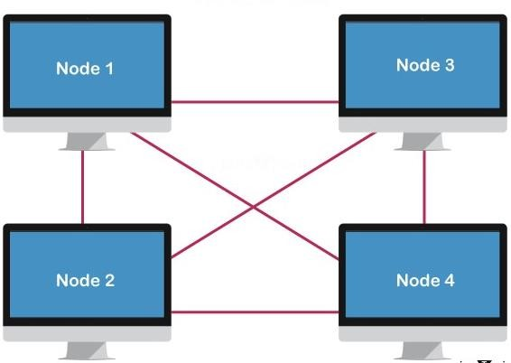
Mesh Topology

Slide 26
Mesh Topology
Mesh technology is an arrangement of the network in which computers are interconnected with each other through various redundant connections.
There are multiple paths from one computer to another computer.
It does not contain the switch, hub or any central computer which acts as a central point of communication.
The Internet is an example of the mesh topology.
Mesh topology is mainly used for WAN implementations where
communication failures are a critical concern.
Mesh topology is mainly used for wireless networks.
Mesh topology can be formed by using the formula:
Number of cables = (n*(n-1))/2
Number of ports = n*(n-1)
Where n is the number of nodes that represents the network.

Slide 27


Categories of Mesh Topology
In a full mesh topology, each computer is connected to all the computers available in the
Full Mesh Topology
network.
In a partial mesh topology, not all but certain computers are connected to those computers with which they communicate frequently.
Partial Mesh Topology

Slide 28



Advantages of Mesh Topology
Reliable:
The mesh topology networks are very reliable as if any link breakdown will not affect the communication between connected computers.
Fast Communication:
Communication is very fast between the nodes.
Easier Reconfiguration:
Adding new devices would not disrupt the communication between other devices.

Slide 29



Disadvantages of Mesh Topology
A mesh topology contains a large number of connected devices such as a router and more transmission media than other topologies.
Cost
Mesh topology networks are very large and very difficult to maintain and manage. If the network is not monitored carefully, then the communication link failure goes undetected.
Management
In this topology, redundant connections are high that reduces the efficiency of the network.
Efficiency

Slide 30
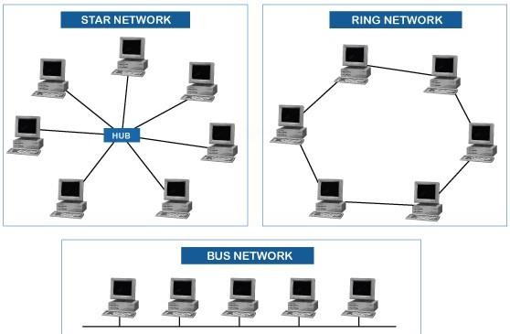
Hybrid Topology

Slide 31
Hybrid Topology
The combination of various different topologies is known as
Hybrid topology.
A Hybrid topology is a connection between different links and nodes to transfer the data.
When two or more different topologies are combined together is termed as Hybrid topology and if similar topologies are connected with each other will not result in Hybrid topology.
For example, if there exist a ring topology in one branch of HBL bank and bus topology in another branch of HBL bank, connecting these two topologies will result in Hybrid topology.

Slide 32
Advantages of Hybrid Topology
Reliable
If a fault occurs in any part of the network will not affect the functioning of the rest of the network.
Scalable
Size of the network can be easily expanded by adding new devices without affecting the functionality
of the existing network.
Flexible
This topology is very flexible as it can be designed according to the requirements of the organization.
Effective
Hybrid topology is very effective as it can be designed in such a way that the strength of the network is maximized and weakness of the network is minimized.

Slide 33



Disadvantages of Hybrid Topology
Complex Design
The major drawback of the Hybrid topology is the design of the Hybrid network. It is very difficult to design the architecture of the Hybrid network.
The Hubs used in the Hybrid topology are very expensive as these hubs are different from usual Hubs used in other topologies.
Costly Hub
Costly Infrastructure
The infrastructure cost is very high as a hybrid network requires a lot of cabling, network devices, etc.

